Slide 1
SYED HASAN SAEED
Email: hasansaeedcontrol@gmail.com
Web Page: hasansaeed872726549.wordpress.com
shasansaeed.yolasite.com

Slide 2
BOOKS
AUTOMATIC CONTROL SYSTEM: KUO & GOLANARAGHI
2. CONTROL SYSTEM: ANAND KUMAR
3. AUTOMATIC CONTROL SYSTEM: S. HASAN SAEED
ELECTRICAL MACINE & AUTOMATIC CONTROL: J.B.GUPTA & S. HASAN SAEED
AUTOMATIC CONTROL SYSTEM: R. A . BARAPATE

Slide 3
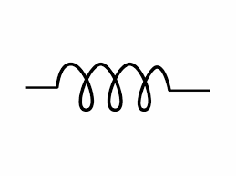
THERMAL SYSTEM
In thermal system, there is transfer of heat from one substance to another substance. The thermal system can be analysed in terms of resistance and capacitance. Let us consider a simple thermal system shown in Fig. 1.
Outlet Water
Inlet Water
Insulated Tank
Fig.1
Heating Element

Slide 4
THERMAL SYSTEM
The tank is insulated to eliminate heat loss to the surrounding air.
There is no heat storage in the insulation.
Suppose water inside the tank having uniform temperature.
Let

Slide 5
THERMAL SYSTEM

Slide 6
THERMAL SYSTEM
Take the Laplace transform of equation (5)
1
63.2%
0
τ
t

Slide 7
THANK YOU

